Slide 1
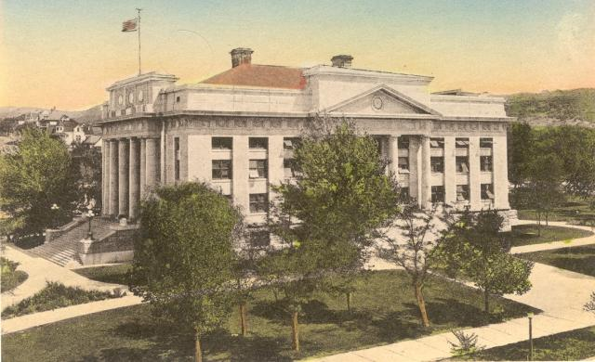
Yavapai County Divorce 101

Slide 2
Welcome to Family Court

Slide 3
Divorce 101: A helpful guide through the divorce process in the Yavapai County Superior Court

Slide 4
The Court
Alternative Dispute Resolution Services
Clerk of the Superior Court
Legal Counsel

Slide 5
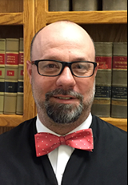
The Court
Honorable John D. Napper
Presiding Judge
Division 2
Superior Court Yavapai County

Slide 6
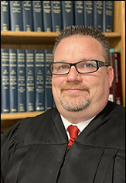
The Court
Honorable Michael P. McGill
Division 1
Superior Court Yavapai County

Slide 7
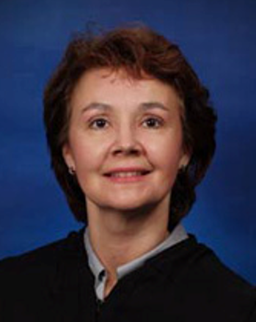
The Court
Honorable Tina R. Ainley
Presiding Domestic Judge
Division 3
Superior Court Yavapai County

Slide 8
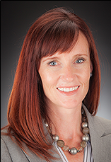
The Court
Honorable Krista M. Carman
Associate Presiding Judge/Presiding Criminal Judge
Division 4
Superior Court Yavapai County

Slide 9
The Court
Honorable Danalyn Savage
Division 5
Superior Court Yavapai County

Slide 10
The Court
Honorable Anna C. Young
Presiding Juvenile Court Judge
Division 6
Superior Court Yavapai County

Slide 11
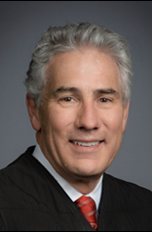
The Court
Honorable Michael R. Bluff
Division 7
Superior Court Yavapai County

Slide 12
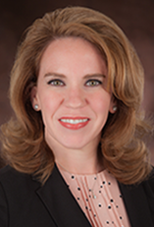
The Court
Honorable Debra R. Phelan
Division 8
Superior Court Yavapai County

Slide 13
The Court
Honorable Kristyne M. Schaaf-Olson
Division PTA
Superior Court Yavapai County

Slide 14
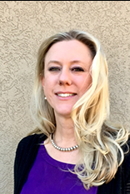
The Court
Honorable Linda Wallace
Division Pro Tem B
Superior Court Yavapai County

Slide 15
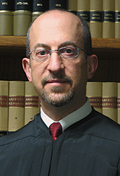
The Court
Honorable Joseph P. Goldstein
Family Law Division
Superior Court Yavapai County

Slide 16
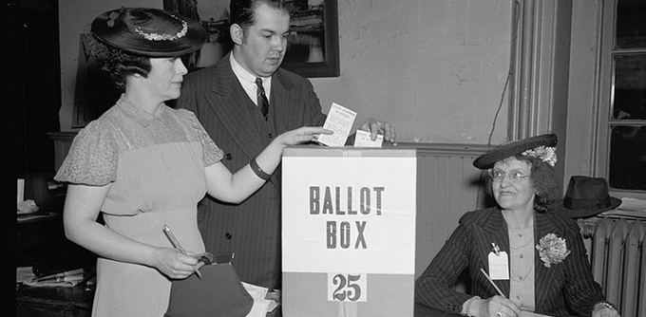
Judges Are:
Elected or Appointed

Slide 17
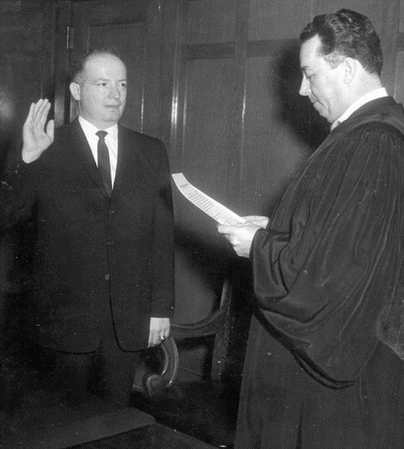
Judges Are:
Sworn to uphold the Laws of Arizona and The Constitution of the United States

Slide 18
Judges Are Not:
Mind Readers

Slide 19
Judges Are Not:
Investigators

Slide 20
Court and Community Resources
Yavapai County Self Service Center
Prescott Law Library (928) 771-3309
Yavapai County Superior Court Clerk’s Office – Prescott (928) 771-3312
Yavapai County Superior Court Clerk’s Office – Verde (928) 567-7741

Slide 21
Court and Community Resources
Yavapai County Self Service Center
Your Source for:
Court Information
Forms and Instructions
Information about Professional Service Providers

Slide 22
Court and Community Resources
Community Legal Services
Prescott Office (928) 445-9240
Verde Valley Sanctuary
Cottonwood Office (928) 639-2079

Slide 23
Court and Community Resources
Modest Means Project
(866) 637-5341 or AZLawHelp.org
Online Legal Help Resources
https://azbf.org/get-involved/i-need-legal-help
Slide 21

Slide 24
Court and Community Resources
Private Attorneys and the State Bar Association
See Bar Directories available in the Law Library
www.azbar.org/findalawyer/

Slide 25
Court and Community Resources
Certified Legal Document Preparers
List available in the Law Library
https://www.azcourts.gov/Portals/26/LDP/Directory/2021%20Directory/LDP%20Master%20Directory%2010-1-2021.pdf?ver=2021-10-13-120421-390

Slide 26
Court and Community Resources
Yavapai County Website
https://courts.yavapaiaz.gov/Departments/Law-Library/Self-Service-Center

Slide 27
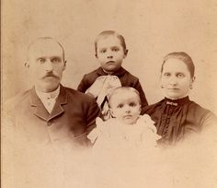
Types of Domestic Cases
Dissolution of Marriage (Divorce)
Legal Separation
Annulment
Paternity
Legal Decision-Making
Support
Parenting Time and/or Visitation

Slide 28
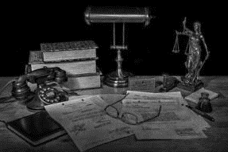
Different Ways Your Case Can Proceed Through Court
Arizona Rules of Family Law Procedure Rule 44: Default (When no response is filed)
By Motion (Without a Hearing) (ARFLP Rule 44. 1)
Default Hearing (ARFLP Rule 44.2)
Publication
Consent Decree (ARFLP Rule 45)
By agreement on all issues (no hearing necessary)
Trial

Slide 29
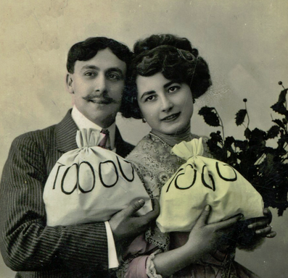
Spousal Maintenance
To qualify for spousal maintenance, you must meet the requirements of Arizona Revised Statutes § 25-319 and a financial affidavit must be filed unless there is an agreement signed by both parties for spousal maintenance.

Slide 30
Communicating with the Court
Judges cannot give you legal advice, cannot talk to you on the phone, or meet with you in their office regarding your case.
This would be considered an “Ex Parte” (one-sided) communication.

Slide 31
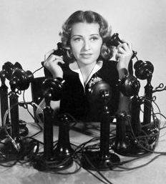
Communicating with Court Staff
Court Staff can give you scheduling and procedural information, but they cannot talk with you about the facts in your case.

Slide 32
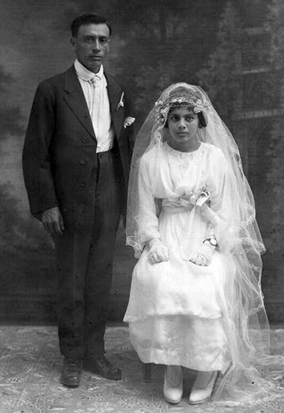
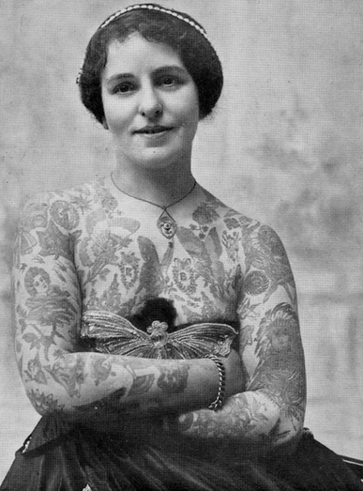
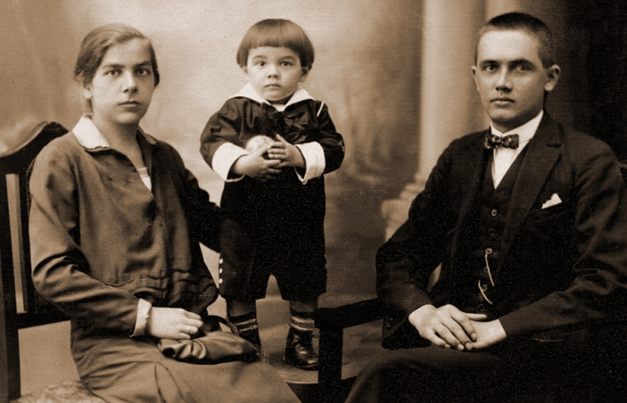
Who Are You?
Parties in cases may be referred to as the following:
Husband / Wife
Father / Mother
Petitioner / Respondent
Obligor / Obligee
Pro Per (Self-Represented Litigant)

Slide 33
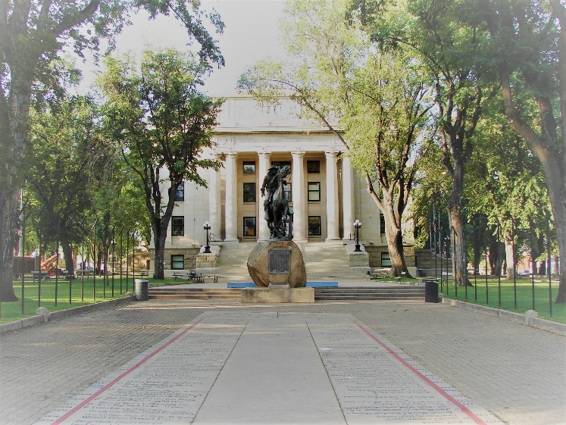
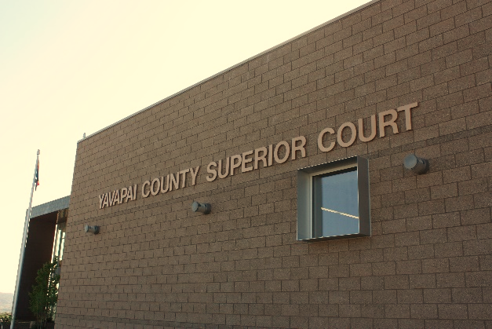
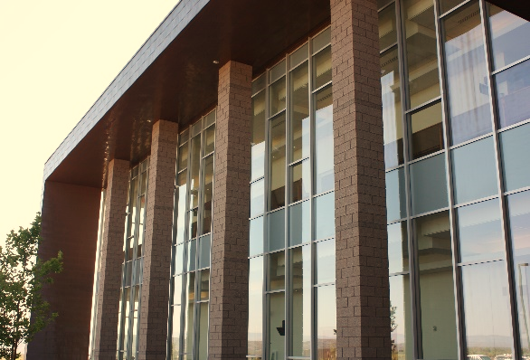
Who Are We?
Yavapai County Courthouse – Prescott, Arizona
Throughout the course of your case, you will come into contact with many, if not all of the following:
Superior Court Judge
Judicial Assistant
Courtroom Bailiff
Court Reporter
Courtroom Clerk
Court Administration
Mediator
Domestic Relations Secretary
Family Law Navigator
Clerk of the Superior Court
Yavapai County Courthouse –
Camp Verde, Arizona

Slide 34
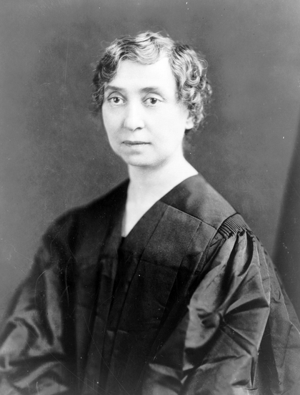
Court and Clerk Staff
Presides over the judicial proceedings in court and over your case
Superior Court Judge

Slide 35
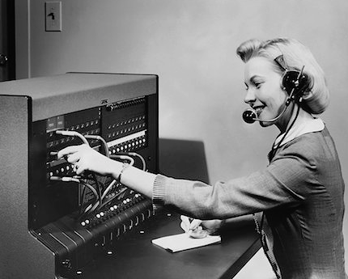
Court and Clerk Staff
Direct assistant to the Judge. Handles files, phone calls, and generates court documents
Judicial Assistant

Slide 36
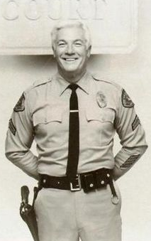
Court and Clerk Staff
Keeps order in the Court and provides logistical assistance to the Judge and parties while in the courtroom
Bailiff

Slide 37
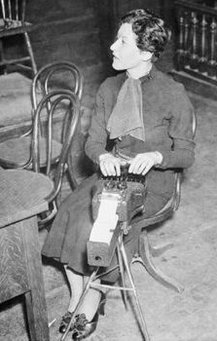
Court and Clerk Staff
Is responsible for the recording of every spoken word while in the Courtroom
Court Reporter

Slide 38
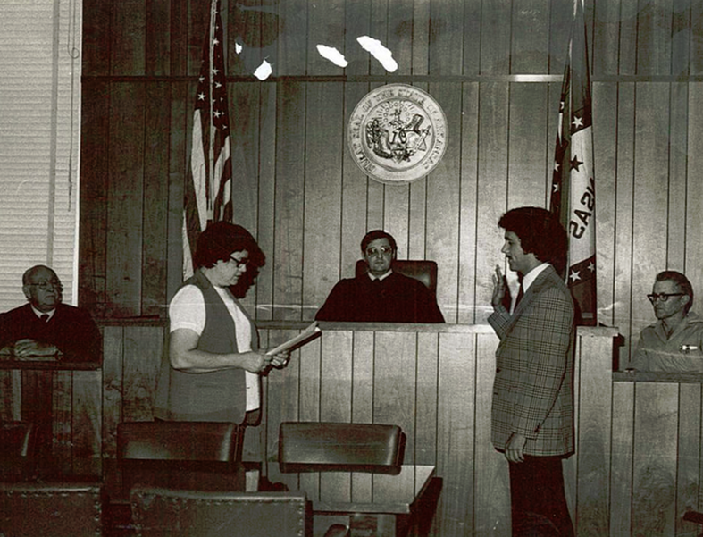
Court and Clerk Staff
Administers the oath and documents the details of the courtroom proceedings
Courtroom Clerk

Slide 39
Questions?

Slide 40
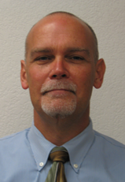
Court Administration
Yavapai County Superior Court Administrator
C. Rolf Eckel

Slide 41
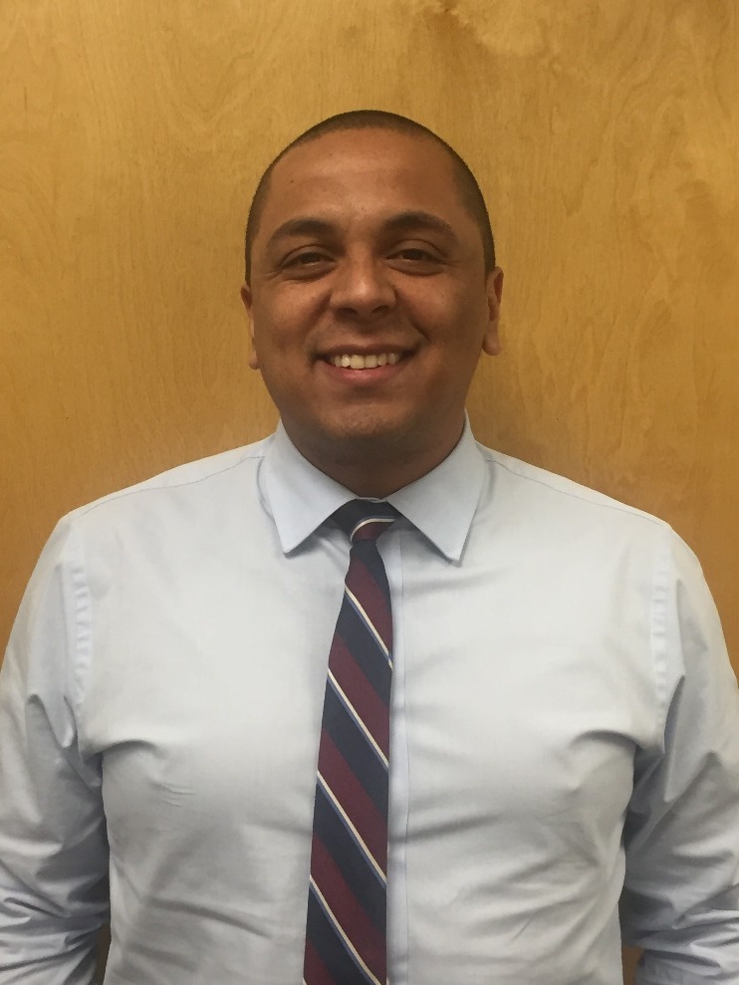
Court Administration
Senior Court Interpreter
Carlos Reyes
Court Interpreter Services

Slide 42
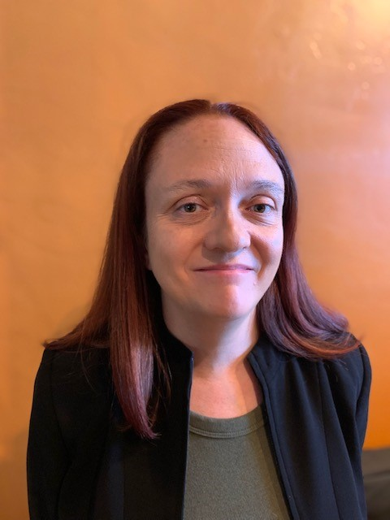
Court Administration
Christy Kalbach, ADR Program Manager
Alternative Dispute Resolution Services (ADR)

Slide 43
Court Administration
Teri Koressel,
ADR Program Coordinator
Jessica Villafaña, Domestic Relations Secretary
Alternative Dispute Resolution Services (ADR)

Slide 44
Court Administration
Shannon Muñoz, Family Law Navigator
Assistance with:
Learning about the family law case flow process
Reviewing completed forms for completeness
Providing Resources
Contact: (928) 777-3082 or YavapaiFLN@courts.az.gov

Slide 45
Alternative Dispute Resolution Services (ADR)
Conciliation Counseling

Slide 46
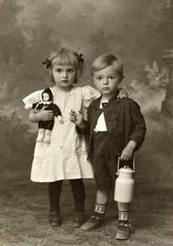
Alternative Dispute Resolution Services (ADR)
Legal Decision Making &
Parenting Time Mediation

Slide 47
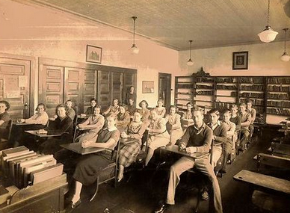
Alternative Dispute Resolution Services (ADR)
Parent Education
Parenting Time Guidelines and many other resources are available in the online course

Slide 48
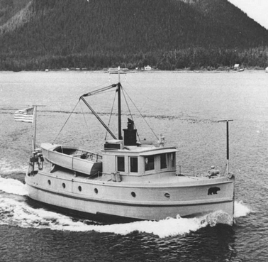
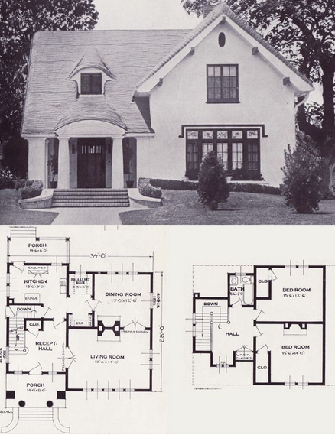
Alternative Dispute Resolution Services (ADR)
Civil Mediation

Slide 49
Alternative Dispute Resolution Services (ADR)
Questions?

Slide 50
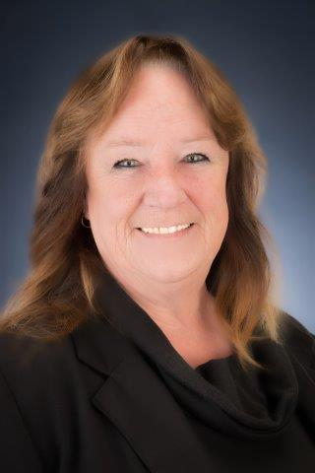
Clerk of the Superior Court
Honorable
Donna McQuality
Yavapai County Clerk of the Superior Court

Slide 51
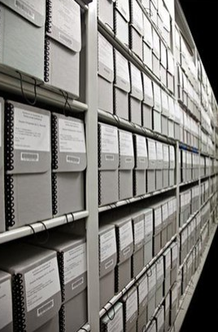
Clerk of the Superior Court
The Clerk of the Superior Court is the keeper of the record and keeps all original documents for the record.

Slide 52
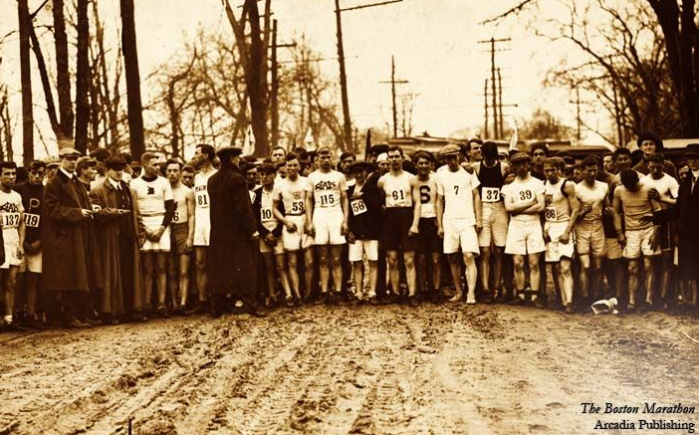
Clerk of the Superior Court
Starting Your Case
The dissolution of marriage begins when you or your spouse files a “Petition for Dissolution of Marriage” with or without minor children.

Slide 53
Clerk of the Superior Court
Sample Dissolution of Marriage Packet
Petition for Dissolution of Marriage
Preliminary Injunction
Notice of Rights about Health Insurance
Notice to Creditors
Summons
Confidential Sensitive Data

Slide 54
Clerk of the Superior Court
Document Requirements For all Papers Filed with the Clerk
Black Ink, 13 –point type size (Times New Roman, Bookman, Century, Garamond, Book Antiqua).
White, 8 ½ x 11 Paper.
Margin Specifications – 2” from the top, 1” from the left, ½” from the right, and ½” from the bottom.
Text should be double spaced on one side of the page only.
Pages shall be numbered.
Leave upper right-hand corner of all documents being filed blank.

Slide 55
Clerk of the Superior Court
Document Requirements For all Papers Filed with the Clerk
All documents must have the filing party’s information in the upper left-hand corner.
The caption and case number remain the same throughout your case. Whoever starts as the Petitioner, stays as Petitioner, no matter who is filing a document.
All documents must be completely filled out. Incomplete information may cause your request to be denied.
Refer to Rule 20
Only originals may be filed
Forms provided by the Court are acceptable.

Slide 56
Clerk of the Superior Court
Starting Your Case
All paperwork should be signed and notarized before you come to the Clerk’s Office, but the Clerk can “verify” respondent’s signature on an Acceptance of Service. You will also need to bring two sets of copies of the documents, one for your records and one for you to serve upon the other party.

Slide 57
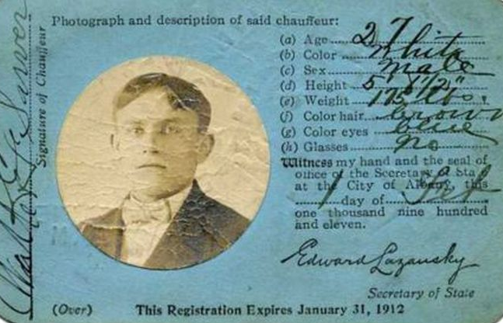
Clerk of the Superior Court
Starting Your Case
Bring your driver’s license or photo identification with you when you file your paperwork.

Slide 58
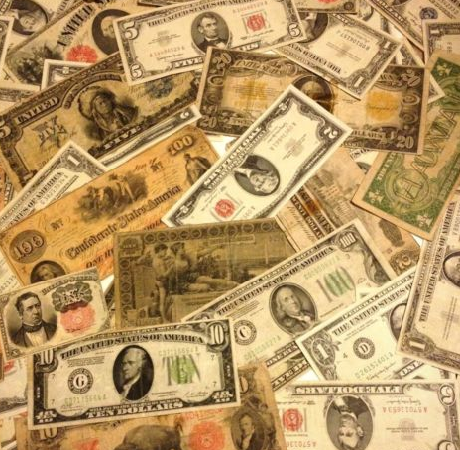
Clerk of the Superior Court
Starting Your Case
A fee is charged when you file your case.
The person who starts the case is
referred to as the Petitioner.
If a response or a consent decree is filed,
the respondent’s appearance fee must also be paid.

Slide 59
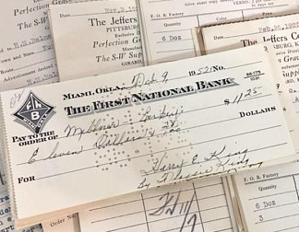
Clerk of the Superior Court
Starting Your Case
The Clerk accepts checks, money orders, most credit cards, and cash. If you need time to pay your fees, you may file for a deferral.

Slide 60
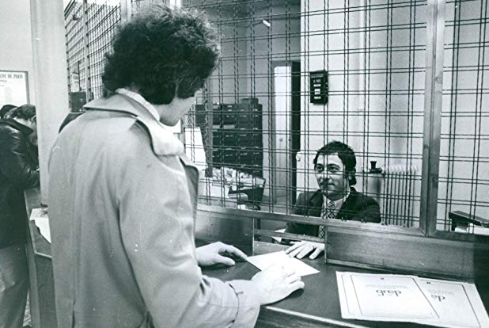
Clerk of the Superior Court
Important Information
The Clerks can explain the meaning of legal terms and documents used in court processes.
The Clerks do attempt to give you options of where you can find information.

Slide 61
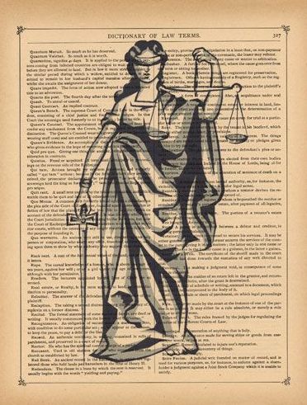
Clerk of the Superior Court
Important Information
If a clerk sees something missing, they can call it to your attention. They cannot tell you how to fill out papers. They cannot give legal advice.

Slide 62
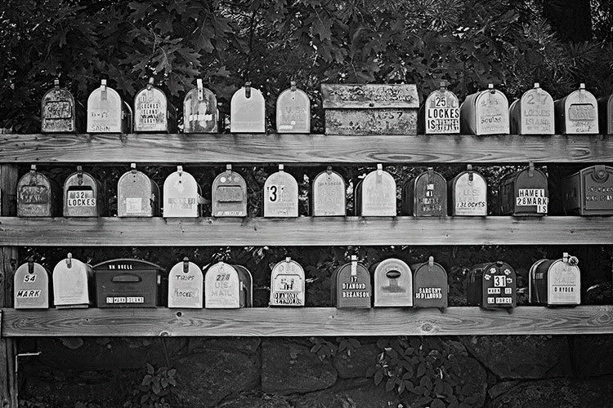
Clerk of the Superior Court
Important Information
You must notify the Clerk IMMEDIATELY in writing if your address changes.
If you do not notify the Court of your new address, you may not get notices and your case may be dismissed or orders may be entered without your knowledge. A form is available in our office and online to do so.

Slide 63
Clerk of the Superior Court
Common Concerns
Situations that may cause a delay in your case.
You are responsible for having the other party served. The Court does not have the other party served.
DOCUMENTS NOT SERVED

Slide 64
Clerk of the Superior Court
Common Concerns
Situations that may cause a delay in your case.
You can serve the other person through the Sheriff’s Office, a private process server, certified restricted mail, or a courier service with a receipt signed by the other party, or by a notarized acceptance of service.
DOCUMENTS NOT SERVED

Slide 65
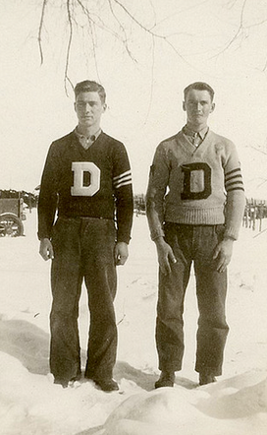
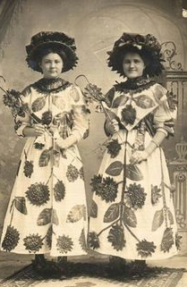
Clerk of the Superior Court
Common Concerns
Situations that may cause a delay in your case.
The Affidavit or Acceptance of Service does not show all the required pleadings were served or the signature is not notarized (if required).
THE WRONG PERSON IS SERVED

Slide 66
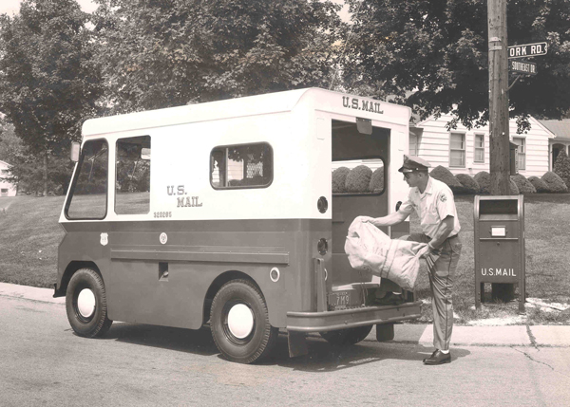
Clerk of the Superior Court
Common Concerns
Situations that may cause a delay in your case.
Application for Default document was not filed and/or a copy was not mailed to the other party.
DEFAULT PAPERWORK

Slide 67
Clerk of the Superior Court
Common Concerns
Situations that may cause a delay in your case.
Parent Education Class was not taken by one or both parties.
PARENT
EDUCATION

Slide 68
Clerk of the Superior Court
Common Concerns
Situations that may cause a delay in your case.
Self Addressed, Stamped Return Envelopes
Copies of Decrees
Parenting Plan or Agreement
Parent’s Worksheet
Child Support Order
Income Withholding Order
Employer Information for Income Withholding Order
Order for Name Change
MISSING DOCUMENTS

Slide 69
Clerk of the Superior Court
Questions?

Slide 70
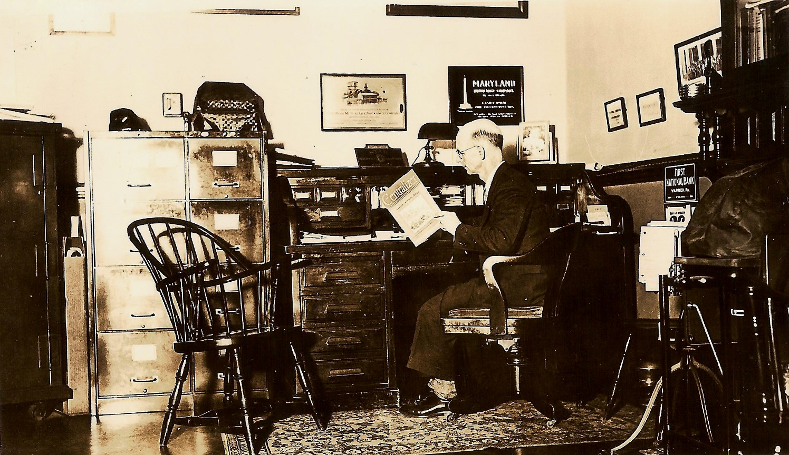
Legal Counsel

Slide 71
Thank You!

